Slide 1
UML Class Diagrams
Notes:
UML Class Diagrams

Slide 2
Today we follow on from Structured Programming last time with a tutorial on creating UML Class Diagrams
Notes:
Today we follow on from Structured Programming last time with a tutorial on creating UML Class Diagrams

Slide 3
UML Diagrams
Class
Object
Package
Composite Structure
Component
Deployment
Profile
Use Case
Activity
State Machine
Sequence
Communication
Timing
Interaction Overview
Prod Tech only use Class Diagrams
Notes:
UML Diagrams
Class
Object
Package
Composite Structure
Component
Deployment
Profile
Use Case
Activity
State Machine
Sequence
Communication
Timing
Interaction Overview
Prod Tech only use Class Diagrams

Slide 4
Diagrams should Tell a Story
Professional programming says
All classes must be included on at least one class diagram.
Select classes for a diagram which will tell a story
Class names and links technically accurate
Extra information to tell the story, but no more
Notes:
Diagrams should Tell a Story
Professional programming says
All classes must be included on at least one class diagram.
Select classes for a diagram which will tell a story
Class names and links technically accurate
Extra information to tell the story, but no more

Slide 5
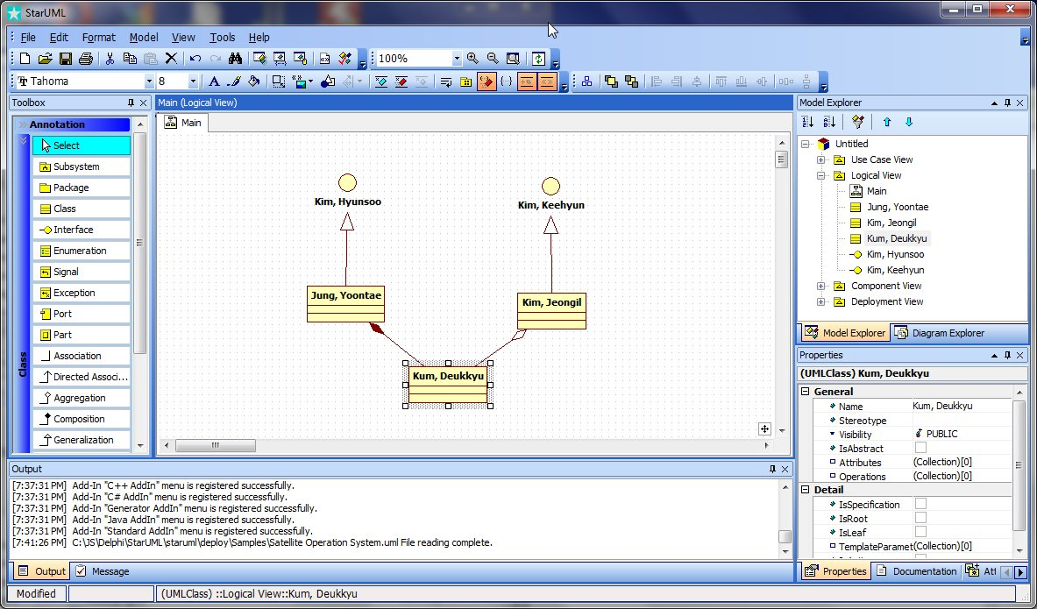
Tool = White Star UML
Notes:
Tool = White Star UML

Slide 6
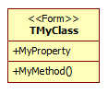
Class
Name
Attributes = Properties
Operations = Methods
StereoType can be used for generic ancestor e.g. form, data record
Notes:
Class
Name
Attributes = Properties
Operations = Methods
StereoType can be used for generic ancestor e.g. form, data record

Slide 7
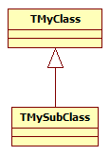
Generalisation = Inheritance
TMySubClass = class(TMyClass);
Note which way the arrow is
Notes:
Generalisation = Inheritance
TMySubClass = class(TMyClass);
Note which way the arrow is

Slide 8
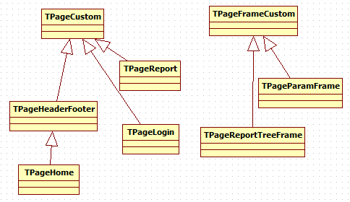
Example Inheritance
Notes:
Example Inheritance

Slide 9
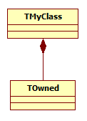
Composition = Ownership
TMyClass = class
FOwned: TOwned;
constructor:
Create FOwned =TOwned.Create;
destructor:
FreeAndNul(FOwned);
property Owned
read FOwned;
end;
Notes:
Composition = Ownership
TMyClass = class
FOwned: TOwned;
constructor:
Create FOwned =TOwned.Create;
destructor:
FreeAndNul(FOwned);
property Owned
read FOwned;
end;
Note that Owned property is not writable

Slide 10
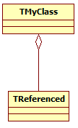
Aggregation = Reference
TMyClass = class
FReferenced: TReferenced;
property Referenced
read FReferenced
write FReferenced;
end;
Notes:
Aggregation = Reference
TMyClass = class
FReferenced: TReferenced;
property Referenced
read FReferenced
write FReferenced;
end;
Note that Owned property IS writable

Slide 11
Examples
Notes:
Examples

Slide 12
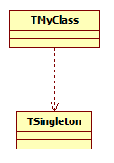
Dependency
TMyClass is dependent on TSingleton, but none of Generalization, Composition or Aggregation apply
Notes:
Dependency
TMyClass is dependent on TSingleton, but none of Generalization, Composition or Aggregation apply

Slide 13
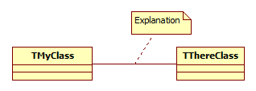
Association
It is useful to the story to show a relationship between two classes, but no other link is appropriate.
Write a comment to explain
Notes:
Association
It is useful to the story to show a relationship between two classes, but no other link is appropriate.
Write a comment to explain

Slide 14
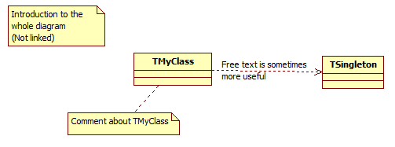
Comments
Comments are good, and should be brief
Notes:
Comments
Comments are good, and should be brief

Slide 15
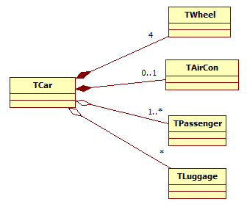
Multiplicity
Optional numbers at the end(s) of the links show how many instances can exist
Notes:
Multiplicity
Optional numbers at the end(s) of the links show how many instances can exist

Slide 16
Examples
Notes:
Examples

Slide 18
Homework
Yaroslav Update class diagram for the System VI Customize Page
Oleg ?
Alexey Update DBvi Prod_Other class diagram
Notes:
Homework
Yaroslav Update class diagram for the System VI Customize Page
Oleg ?
Alexey Update DBvi Prod_Other class diagram

